Slide 1
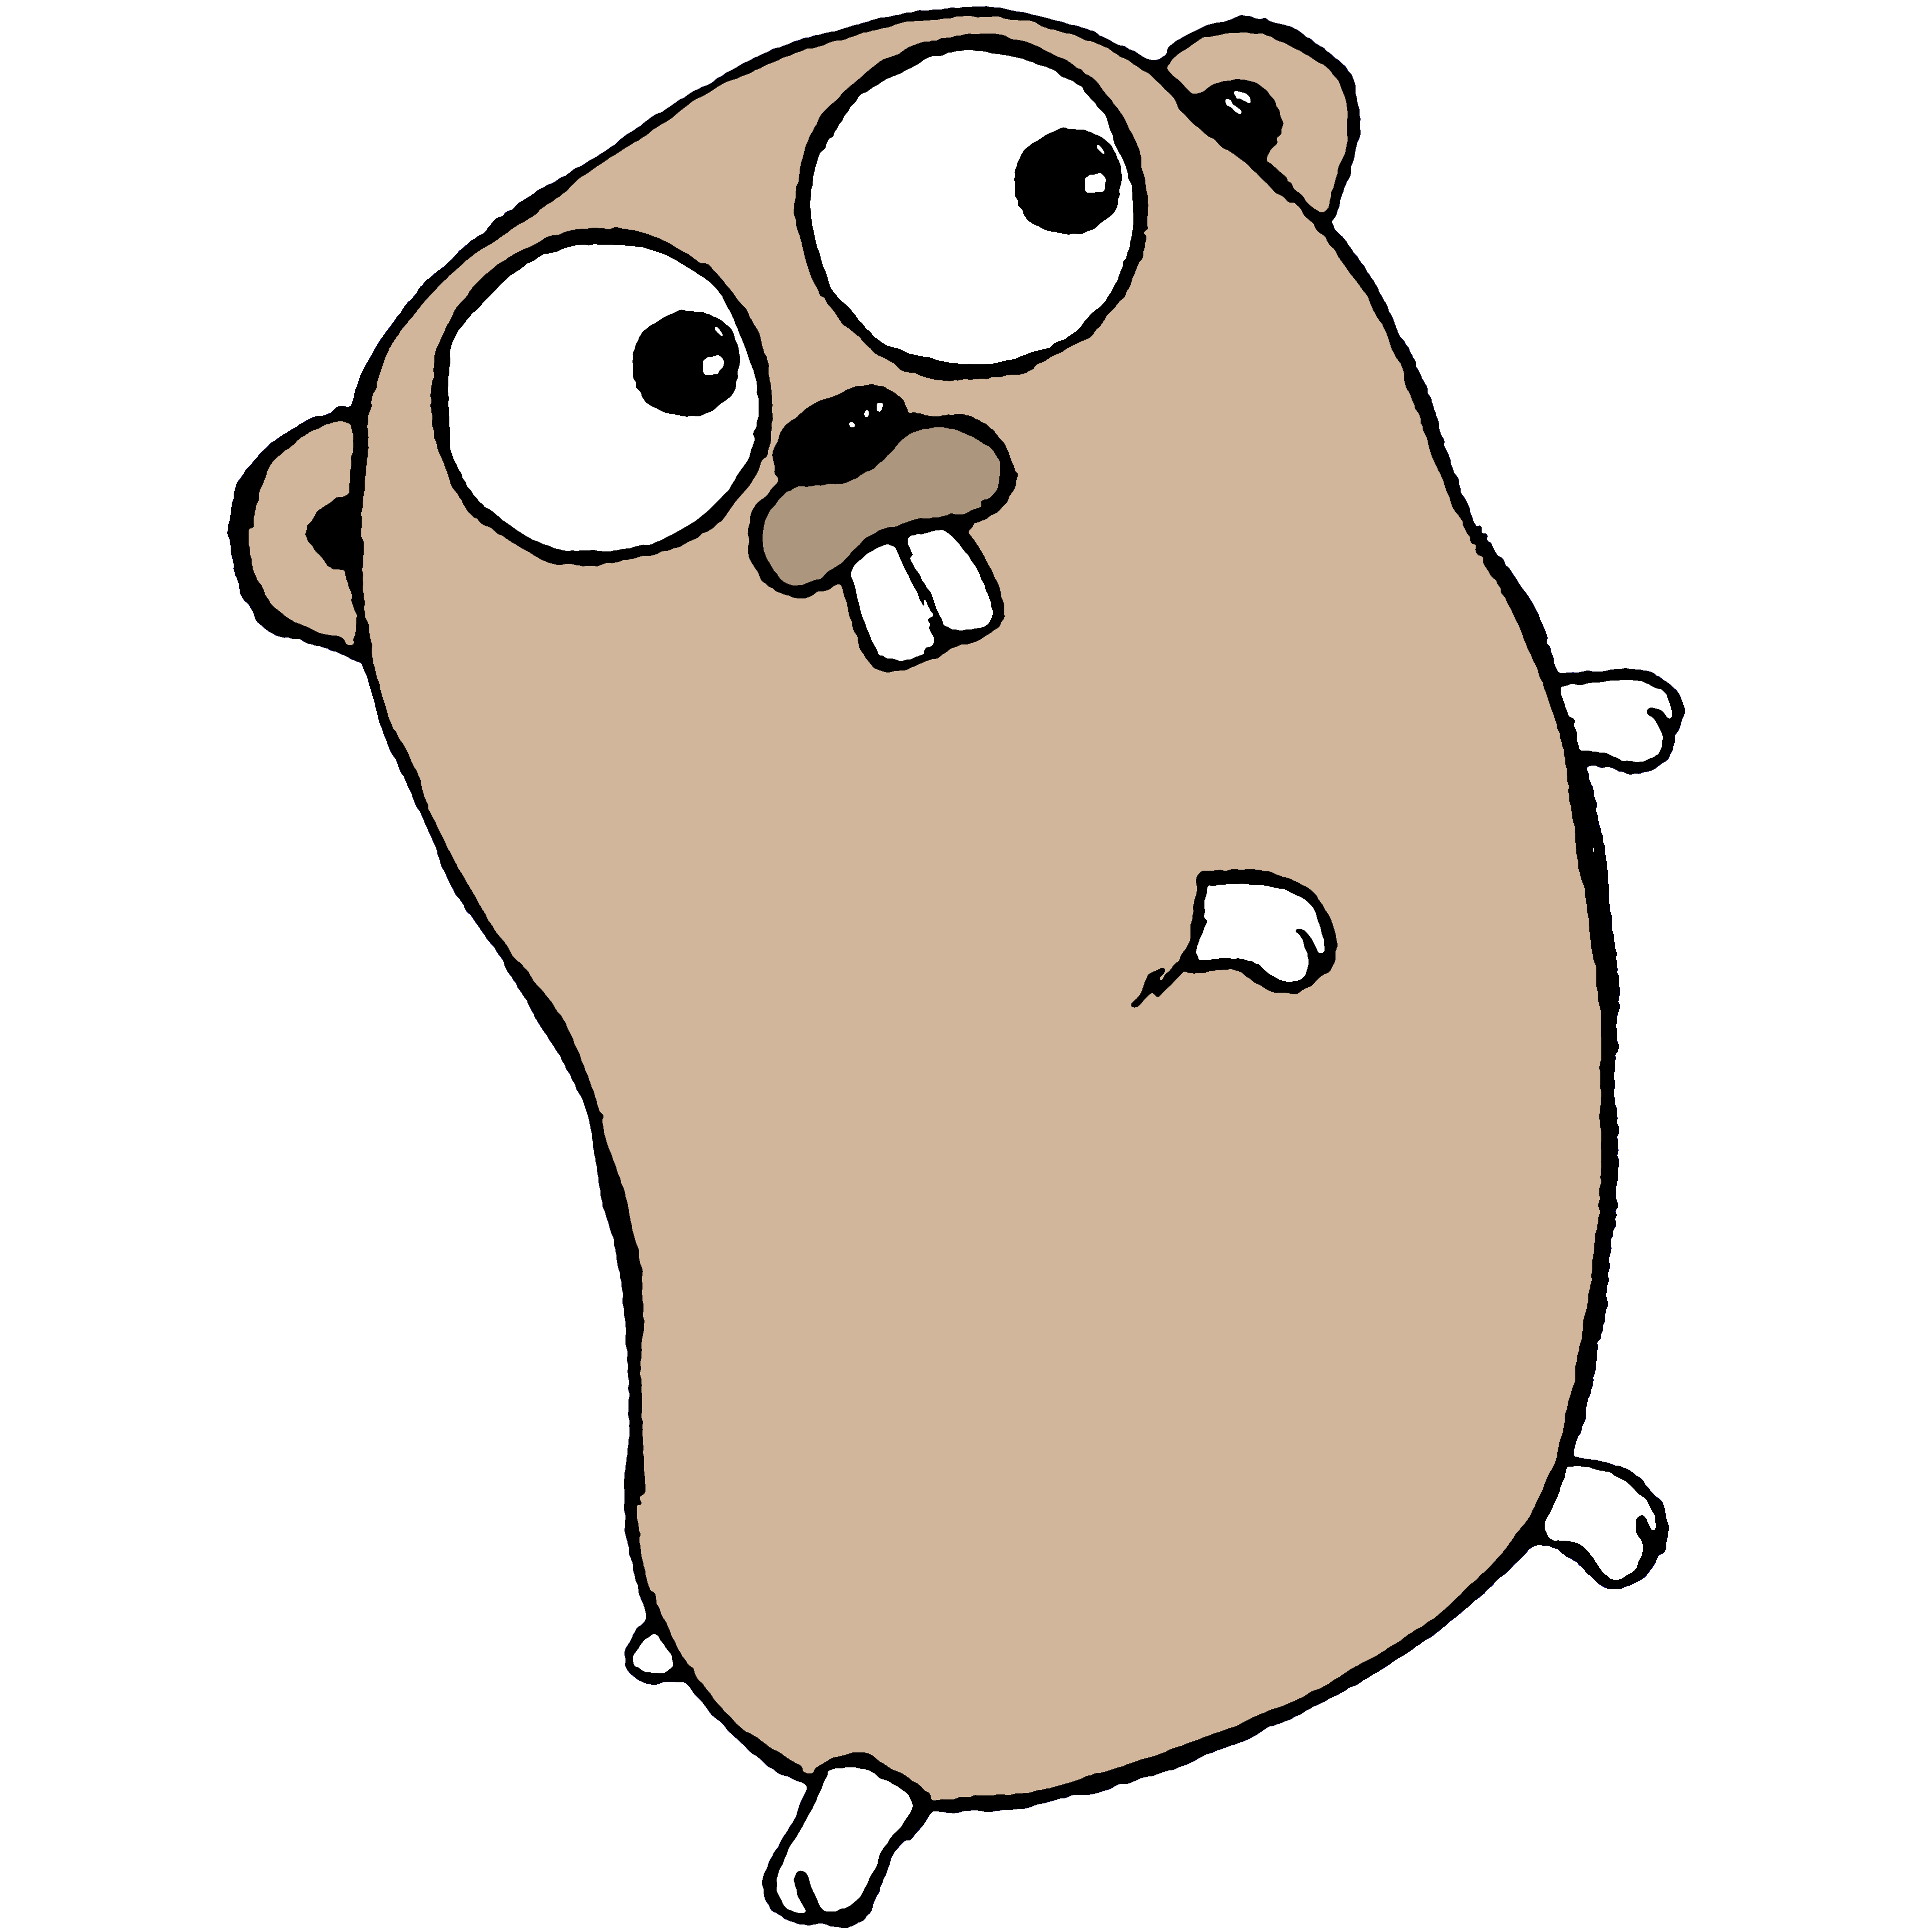
#golang beginner’s workshop
Chetan Sachdev
@cksachdev

Slide 2
me
i_am := “Chetan Sachdev”
myJob := “Practice lead (Flash Platform) @ Tarento Technologies Pvt Ltd”
i_am != “an expert in #golang”

Slide 3
Introduction
Go is a concurrent open source programming language developed at Google.
Compiled
Statically typed
Concurrent
Simple
Productive

Slide 4
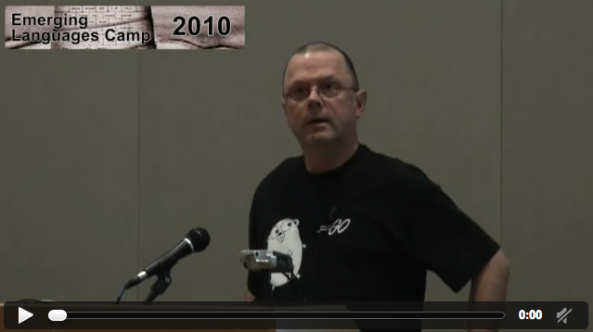
Evolution of Go
Emerging Languages Camp 2010
http://confreaks.com/videos/115-elcamp2010-go by Rob Pike
and Read the 1978 CSP paper. CSP stands for Communicating sequential processes by C. A. R. Hoare http://en.wikipedia.org/wiki/Communicating_sequential_processes

Slide 5
Agenda
Setup golang dev environment
golang basics
“Hello World” program
Variables and constants
Branching (if/else and switch)
Loops
Functions
Structure
Go routines
Resources

Slide 6
Installation
Download go package from https://code.google.com/p/go/downloads/list
Follow installation steps described at http://golang.org/doc/install
Or
Follow along with http://tour.golang.org/
Download slides and source files from https://github.com/cksachdev/golang-presentations/tree/master/beginner
Choose your code editor

Slide 7
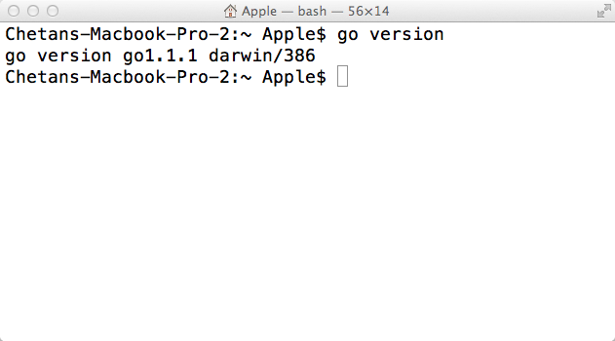
Validate installation
Open console and run this command

Slide 8
01-helloworld.go
package main
import "fmt"
func main() {
fmt.Println("hello world")
}

Slide 9
02-variables.go
package main
import "fmt"
var gi int
func main() {
fmt.Println(gi) //0
var i int
fmt.Println(i) //0
i = 25
fmt.Println(i) //25
j := 5
s := "Hello!"
fmt.Println("The two values are:", j, s)
//The two values are: 5, Hello
fmt.Printf("The integer is %d, and the string is %s.\n", j, s)
//The integer is 5, and the string is Hello.
var arr1 []int
arr1 = []int{1, 2, 3, 4}
arr2 := []int{1, 2, 3, 4}
fmt.Println(arr1, arr2) //[1,2,3,4] [1,2,3,4]
}

Slide 10
03.1-branchingif.go
package main
import "fmt"
func main() {
if 7%2 == 0 {
fmt.Println("7 is even")
} else {
fmt.Println("7 is odd")
}
if 8%4 == 0 {
fmt.Println("8 is divisible by 4")
}
if num := 9; num < 0 {
fmt.Println(num, "is negative")
} else if num < 10 {
fmt.Println(num, "has 1 digit")
} else {
fmt.Println(num, "has multiple digits")
}
}

Slide 11
03.2-branchingswitch.go
package main
import ("fmt”)
func main() {
i := 2
fmt.Print("write ", i, " as ")
switch i {
case 1:
fmt.Println("one")
case 2:
fmt.Println("two")
case 3:
fmt.Println("three")
}
}

Slide 12
03.2.1-branchingswitch.go
package main
import ("fmt", "time")
func main() {
switch time.Now().Weekday() {
case time.Saturday, time.Sunday:
fmt.Println("it's the weekend")
default:
fmt.Println("it's a weekday")
}
t := time.Now()
switch {
case t.Hour() < 12:
fmt.Println("it's before noon")
default:
fmt.Println("it's after noon")
}
}

Slide 13
04-loops.go
package main
import "fmt"
func main() {
arr := []int{1, 2, 3, 4}
fmt.Println("\nWithin for loop ...")
for i := 0; i < len(arr); i++ {
fmt.Println(i)
}
j := 0
fmt.Println("\nWithin infinite for loop ...")
for {
if j > len(arr) {
break
}
fmt.Println(j)
j = j + 1
}
}

Slide 14
05-functions.go
package main
import (
"fmt"
)
func Add(i, j int) int {
return i + j
}
func main() {
s := Add(5, 10)
fmt.Println("Sum is: ", s)
}

Slide 15
05.1-multipleassignment.go
package main
import (
"fmt"
"strconv"
)
func SumProd(i, j int) (int, int) {
return i + j, i * j
}
func main() {
s, p := SumProd(5, 6)
fmt.Println(s, p)
arr := []string{"Hello", "how", "are", "you?"}
for i, v := range arr
fmt.Println(i, v)
}
a := "20a"
if _, err := strconv.Atoi(a); err != nil {
fmt.Println("Error! ", err)
}
}

Slide 16
06-structure.go
package main
import "fmt"
type MyCar struct {
color string
maxSpeed int
}
func main() {
m := MyCar{}
fmt.Println(m) //{ 0}
m = MyCar{"red", 100}
fmt.Println(m) //{red, 100}
m.color = "blue"
m.maxSpeed = 150
fmt.Println(m) //{blue, 150}
fmt.Println("color is:", m.color)
//color is: blue
m = MyCar{maxSpeed: 150, color: "green"}
fmt.Println(m) //{green, 150}
}

Slide 17
06.1-structuremethods.go
package main
import "fmt"
type MyCar struct {
speed int
}
func (m *MyCar) acc() {
m.speed = m.speed + 10
}
func main() {
m := MyCar{}
fmt.Println(m)
m.acc()
fmt.Println(m)
}

Slide 18
07-goroutines.go
package main
import "fmt”
func f(from string) {
for i := 0; i < 3; i++ {
fmt.Println(from, ":", i)
}
}
func main() {
f("direct")
go f("goroutine")
go func(msg string) {
fmt.Println(msg)
}("going")
var input string
fmt.Scanln(&input)
fmt.Println("done")
}

Slide 19
Resources
Tools
Editors http://go-lang.cat-v.org/text-editors/
Books
Learning go http://www.miek.nl/projects/learninggo/
GoProgramming http://archive.org/details/GoProgramming
Network programming with go http://jan.newmarch.name/go/
www
go-wiki https://code.google.com/p/go-wiki/w/list
Gobyexample https://gobyexample.com/

Slide 20
Look into the source
Blog engine https://github.com/PuerkitoBio/trofaf

Slide 21
Credits
Sathish VJ https://github.com/sathishvj/golang-workshops/tree/master/beginner/

Slide 22
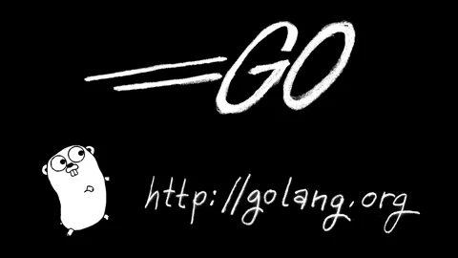
Questions? Chetan Sachdev @cksachdev http://chetansachdev.com

